Slide 1
PL-600 Power Automate

Slide 2
Agenda
Discuss options for automation and custom logic
Review considerations for using triggers and common actions
Explore using Business Process Flows to guide users through business processes

Slide 3
Options for automation and custom logic
Business Rules
Microsoft Dataverse Classic Workflow
How do you decide when you should use each of these?
Power Automate
Microsoft Dataverse Plug-ins
Notes:
Use this to start the discussion with the class, after the discussion use the next few slides to cover any key points not raised

Slide 4
Options for automation and custom logic
Business Rules
Good for simple validation or setting of values
Optimized to run as part of the transaction for modifications that occur on the rows
No ability to use related rows or connectors
Can also be configured to run in model-driven apps for basic UX operations like hide/show
Available scope- single form, all forms, table
Microsoft Dataverse Classic Workflow
Power Automate
Microsoft Dataverse Plug-ins
Notes:
Can be challenging if mixing with developer created Form Scripting, rule will not trigger script, and script will not trigger rules
Make sure to touch on table scope vs form where it runs on model-driven client only
Common challenges with Form Scripting – Not all columns on form rule won’t run
Can only reference columns on table, can use Calculated column with N:1 relationship to access related rows

Slide 5
Options for automation and custom logic
Business Rules
Primary scenario is when real-time processing is required
Power Automate should be the first choice for background operations
Microsoft Dataverse Classic Workflow
Power Automate
Microsoft Dataverse Plug-ins

Slide 6
Options for automation and custom logic
Business Rules
Primary choice for non-real time automation
Supports near real-time triggering from Microsoft Dataverse
Support for connector and UI automation and Business Process Flows
Microsoft Dataverse Classic Workflow
Power Automate
Microsoft Dataverse Plug-ins

Slide 7
Options for automation and custom logic
Custom logic is an extension of the Microsoft Dataverse operation
Ability to modify the request and response on the fly
Able to handle complex logic
Requires code developer skills
Can be either synchronous or asynchronous
Business Rules
Microsoft Dataverse Classic Workflow
Power Automate
Microsoft Dataverse Plug-ins

Slide 8
Power Automate
Data and Services via Connectors
Robotic Process Automation
300+ public connectors
Custom connectors for other REST APIs
UI Automation
Row windows and web app user interactions
Replay as part of flows
Attended or unattended
Business Process Flows
Interactive guide to get work done
Track major milestones in long running processes

Slide 9


Microsoft Dataverse connectors
Replaced by Microsoft Dataverse connectors
OK for continued use on existing flows
Dynamics 365
Use when not using solutions
Use when you need to integrate across environments
Microsoft Dataverse
Use when flow is built in a solution
Use when talking to Microsoft Dataverse in the same environment
Microsoft Dataverse
(Current Environment)

Slide 10
What are considerations when choosing and using a trigger for a flow?
Classroom discussion
Notes:
Push the class to talk about triggers
If they are quiet, you can encourage them with:
How can you avoid indefinite loops?
What are good scenarios where when a row is selected is useful and any considerations for use?

Slide 11
Trigger Considerations
Use filters and scoping options to reduce unnecessary execution and indefinite loops
Remember update means column was included in request not that the value has changed
Button and selected row triggers aren’t currently visible from apps if flow is in a solution
Notes:
Normal Microsoft Dataverse triggers do not provide

Slide 12
Getting data
When available specify columns that are required for flow
When referencing data previously retrieved earlier in the flow, the data is not updated automatically after the original step executes
With most Microsoft Dataverse triggers they provide all the columns and you don’t need to explicitly retrieve the row right after the trigger runs
When a row is selected doesn’t include N:1 lookup columns
Delete only includes the ID of the row no other columns
If the Microsoft Dataverse trigger doesn't provide some column values, get the row after the trigger runs
Notes:
Specify columns, if you don’t do this you can hit limits on data returned

Slide 13
Getting lists of data
Always filter the data on the connector not after using other actions
FetchXML query filters can do more advanced criteria including related table
Enable pagination if you want more than one page of data
Page size is determined by the connector e.g. Microsoft Dataverse is 1024
Pagination is enabled via action settings
Limit is 100,000 rows, partition query if you need more
Notes:
You must visit Settings on actions to enable pagination

Slide 14
Updating data
Include only the columns that have changed
Avoids triggering other automation and audit logging
Use null expression to clear values
Can provide Microsoft Dataverse primary ID and upsert will occur, ensure you provide all the required columns
Notes:
Upsert – Update if exists, otherwise create the row

Slide 15
Your flow did the following: - Created an item in a SharePoint List - Tried to create a row in Microsoft Dataverse and failed When this failure happens you want to undo the create of the SharePoint list item, what should you do?

Slide 16
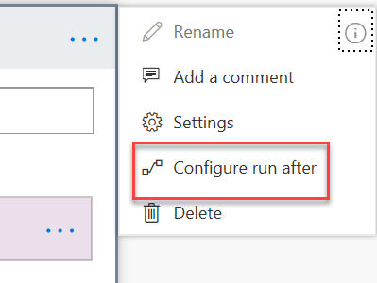
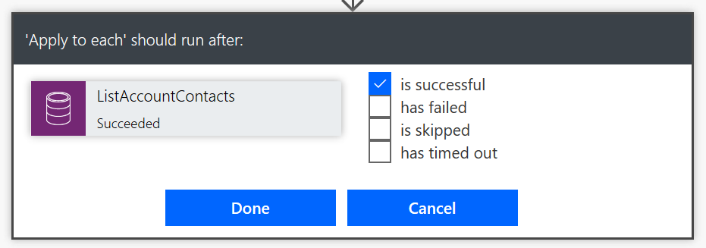
Handling Errors
Notes:
Use this to compensate (do some undo work) for prior errors or could be used to have logic when a timeout occurs like when an approval times out

Slide 17
Your flow needs to do the following: - Update the number of cases available on account - Create a case - Create a task to follow up What can you do to ensure that all of these work or none of these work?

Slide 18
Staying within the limits
Many operations like Apply for Each only work up to 100,000 and might require partitioning work when working with large sets of items
Do Until has default of 60 loops or 1 hour of execution
Connectors have throttling limits check the docs for details
Flows can execute for only up to 30 days, plan around if you have scenarios needing to run longer
Notes:
Do Until limits are not errors but are treated as a success for ending the loop

Slide 19
What can your team do to make flows they build more maintainable?
Classroom discussion

Slide 20
Building maintainable flows
Use meaningful naming conventions – consider admins and users
Rename each action e.g. Get List to Get Account Contacts
Use comments on actions to document purpose
Use child flows to prevent overly complex flows or repeated logic

Slide 21
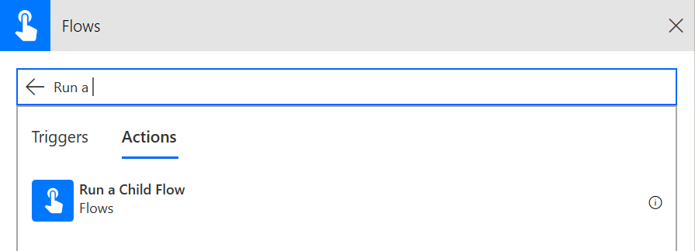
Using Child Flows
Allows breaking out parts of a flow into a reusable child flow
Trigger Support of child flows
Manually triggered button flow
Power Apps
HTTP Request
Respond with Power Apps or HTTP response
Requires current environment connector
Notes:
Manual – Use this when you also want your child flow to be run interactively as well as a child flow.
Power Apps – This is the most general purpose way to use child flows – also allows reuse from a canvas app, but does not allow users to run manually. Definition of parameters is done visually
HTTP Request – This is the most powerful trigger for child flows, input options are defined with JSON sample or JSON schema and are not limited to the fixed parameters of the other options.

Slide 22
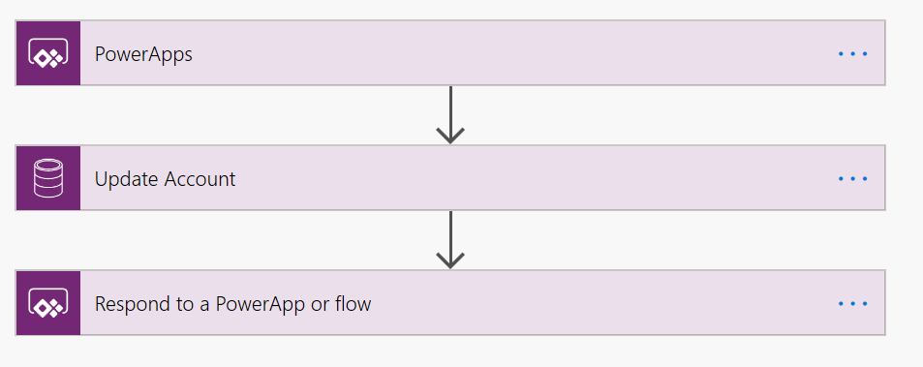
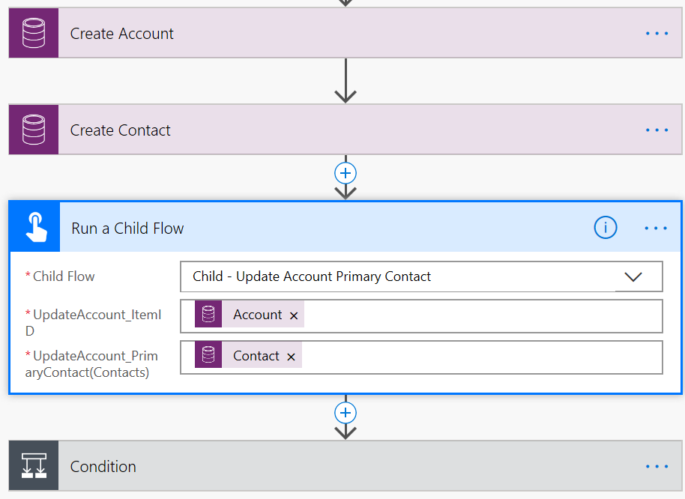
Example – using a child flow
Parent flow
Child flow
Notes:
Example – refactors out updating the primary contact on an account – could include other actions like scheduling call with new contact etc.

Slide 23
Microsoft Dataverse connector user security context
Instant Flows
Scheduled Flows
Automated Flows
Co-Owner or Run-Only
Allow using existing connection or require them to use their own
Can choose for each connection used
Settings are for all Run-only users, you can’t individually set
Co-Owner
Uses existing connection, any owner can change
Co-Owner
Uses existing connection, any owner can change
Notes:
Instant flows are Button triggers, and When a row is selected triggers

Slide 24
How do you know if you have a good candidate for using Business Process Flows ?
Classroom discussion

Slide 25
Business Process Flows
Encourage outcomes, not wizard data capture
Link between related or unrelated table types, automatic form transition
Amplifies change to form approach
Triggers automation based on progression
Now automatable with CRM 2015
Notes:
Seamless transition through multiple related table without interruptions in UX.

Slide 26
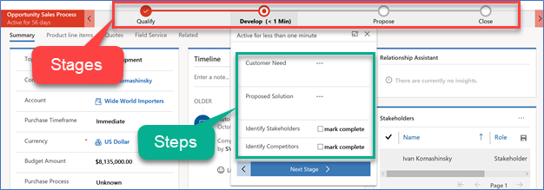
Business Process Flows
A guide, roadmap,
recipe, …
Stages and steps
Stage gating
Conditional branching
Include multiple table
Switch at any time
Role tailored
Automation and Developer APIs
Notes:
Spend as much time as necessary making sure the audience has an understanding of the basics of Business Process Flows

Slide 27
How do you decide between one process with branching or multiple processes?
Classroom discussion

Slide 28
Choosing one or multiple processes
Do the processes need to run concurrently?
Does returning to same place after branch?
How will you handle new row Business Process Flow assignment?

Slide 29
Which process shows on row open
Process instance table keeps track of actively running instances
Instances are filtered by user permission and order
A user-specific cache keeps track of per row selection to help with multi-user scenarios to maintain stability
Developer client scripting only changes the view for the specific user interacting with the process control
Notes:
The user selection persistence is temporary. It is used to ensure that the user selection does not change within the same session. In a limited manner, it is also persisted across sessions so that if the user opens the same row the selection is remembered. More specifically, the system uses the same
Most Recently Used (MRU) cache to keep track of user selection and holds up to 40 user selections, for example row to BPF instances
More details here - https://blogs.msdn.microsoft.com/crm/2017/07/30/how-to-determine-which-business-process-flow-bpf-instance-is-shown-when-a-record-is-opened-2/
Start Time xx:xx / Length: 2 minutes
Review the learning objectives.

Slide 30
Business Process Flow considerations
Can be used standalone outside the context of a model-driven app using a per process license
Process table is customizable, and can be added directly to app navigation
Process management can be automated via API or Power Automate to start/stop process as well advance stages automatically
Can be included in an app or standalone (immersive BPF)
Include up to 5 table per process
Related or not

Slide 31
Wrapping up
Power Automate should be your go to tool for automation and custom logic on Microsoft Power Platform projects
Solution Architects should work with their teams to ensure consistency in use and use flow reviews to improve quality
Always strive to use solutions for your automation

Slide 32
Group exercise: Evaluate automation options
Evaluate needs
Discuss pros and cons of options

